Slide 1
ADDER,MULTPLIER
AND,XOR

Slide 2
ADDER
Use of one bit full adder
Ripple eight times
Sum=xor(a[i],b[i],ci)
C(i+1)=or(a[i]&b[i],a[i]&cin,b[i]&cin)
...Using operation in binary number(addition)
...We get sum and carry of two 8 bit signed number

Slide 3
module adder_8bit(a,b,cin,sum,cout );
input [7:0]a,b;
input cin;
output [7:0]sum;
output cout;
wire [6:0]c;
fulladder a1(a[0],b[0],cin,sum[0],c[0]);
fulladder a2(a[1],b[1],c[0],sum[1],c[1]);
fulladder a3(a[2],b[2],c[1],sum[2],c[2]);
fulladder a4(a[3],b[3],c[2],sum[3],c[3]);
fulladder a5(a[4],b[4],c[3],sum[4],c[4]);
fulladder a6(a[5],b[5],c[4],sum[5],c[5]);
fulladder a7(a[6],b[6],c[5],sum[6],c[6]);
fulladder a8(a[7],b[7],c[6],sum[7],cout);
endmodule
C
O
D
E
module fulladder(a,b,cin,sum,cout);
input a,b,cin;
output sum,cout;
assign sum=(a^b^cin);
assign cout=((a&b)|(b&cin)|(a&cin));
endmodule
8 bit ADDER

Slide 4
module adder_8bit_tb;
// Inputs
reg [7:0] a;
reg [7:0] b;
reg cin;
// Outputs
wire [7:0] sum;
wire cout;
// Instantiate the Unit Under Test (UUT)
adder uut (
.a(a),
.b(b),
.cin(cin),
.sum(sum),
.cout(cout)
);
TEST BENCH OF ADDER
initial begin
// Initialize Inputs
a = 0; b = 0; cin = 0;
// Wait 100 ns for global reset to finish
#100 a=8'b000001001; b=8'b11111110; cin=1'b0;
#100 a=8'b11111100; b=8'b00001010; cin=1'b0;
#100 $stop;
// Add stimulus here
end
endmodule

Slide 5
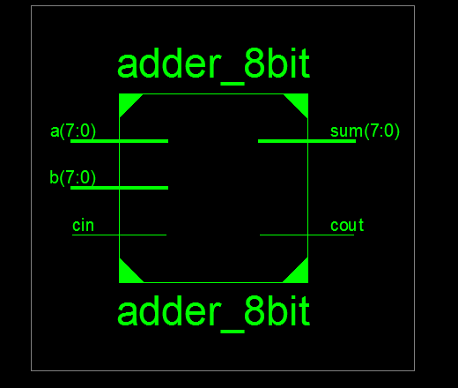
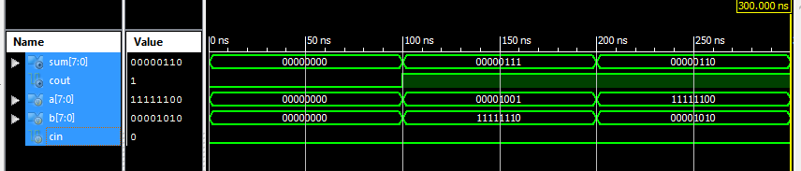
:-Adder Block Diagram
:-Waveform of an adder

Slide 6
MULTIPLIER
Using booth’s multiplier
Cases of (01<-sum,10<-sub,{11,00}default)
Sum=A+M, Sub=A+~M+1
Use of temporary and parameter variable helps in Arithmetic right shift at each step considering the case values
Since 8 bit multiplication 8 steps will go, each step temp variable stores value of A,Q,Q_1 and put value in parameter
In main module calculates the values(A,Q,Q_1) at different step
We get our answer at final step in A and Q(16 bit).

Slide 7
module mult_8bit(Multiplier,Multiplicand,Product);
input [7:0]Multiplier;
input [7:0]Multiplicand;
output [15:0]Product;
wire [7:0]A1,A2,A3,A4,A5,A6,A7,A8;
wire [7:0]Q1,Q2,Q3,Q4,Q5,Q6,Q7,Q8;
wire Q_11,Q_12,Q_13,Q_14,Q_15,Q_16,Q_17,Q_18;
Mult M1(8'b00000000,Multiplier,Multiplicand,1'b0,A1,Q1,Q_11);
Mult M2(A1,Multiplier,Q1,Q_11,A2,Q2,Q_12);
Mult M3(A2,Multiplier,Q2,Q_12,A3,Q3,Q_13);
Mult M4(A3,Multiplier,Q3,Q_13,A4,Q4,Q_14);
Mult M5(A4,Multiplier,Q4,Q_14,A5,Q5,Q_15);
Mult M6(A5,Multiplier,Q5,Q_15,A6,Q6,Q_16);
Mult M7(A6,Multiplier,Q6,Q_16,A7,Q7,Q_17);
Mult M8(A7,Multiplier,Q7,Q_17,A8,Q8,Q_18);
assign Product = {A8,Q8};
endmodule
C
O
D
E
MULTIPLIER

Slide 8
module Mult(A,M,Q,Q_1,nA,nQ,nQ_1);
input [7:0]A,M,Q;
input Q_1;
output [7:0]nA,nQ;
output nQ_1;
reg[7:0]nA_t,nQ_t;
reg nQ_1_t;
wire [7:0]sum,sub;
assign sum=A+M;
assign sub=A+~M+1;
C
O
D
E
MULTIPLIER

Slide 9
always @(A,Q,M,Q_1,sum,sub)
begin
case ({Q[0],Q_1})
2'b01:
begin
nA_t={sum[7],sum[7:1]};
nQ_t={sum[0],Q[7:1]};
nQ_1_t=Q[0];
end
2'b10:
begin
nA_t={sub[7],sub[7:1]};
nQ_t={sub[0],Q[7:1]};
nQ_1_t=Q[0];
end
default :
begin
nA_t={A[7],A[7:1]};
nQ_t={A[0],Q[7:1]};
nQ_1_t=Q[0];
end
endcase
end
assign nA=nA_t;
assign nQ=nQ_t;
assign nQ_1=nQ_1_t;
endmodule
C
O
D
E
MULTIPLIER

Slide 10
module mult_8bit_tb;
// Inputs
reg [7:0] Multiplier;
reg [7:0] Multiplicand;
// Outputs
wire [15:0] Product;
// Instantiate the Unit Under Test (UUT)
mult_8bit uut (
.Multiplier(Multiplier),
.Multiplicand(Multiplicand),
.Product(Product)
);
TEST BENCH OF MULTIPLIER
initial begin
// Initialize Inputs
Multiplier = 0;
Multiplicand = 0;
// Wait 100 ns for global reset to finish
#100 Multiplier=8'b00001011; Multiplicand=8'b00000011;
#100 Multiplier=8'b00001011; Multiplicand=8'b11111101;
#100 $stop;
// Add stimulus here
end
endmodule

Slide 11
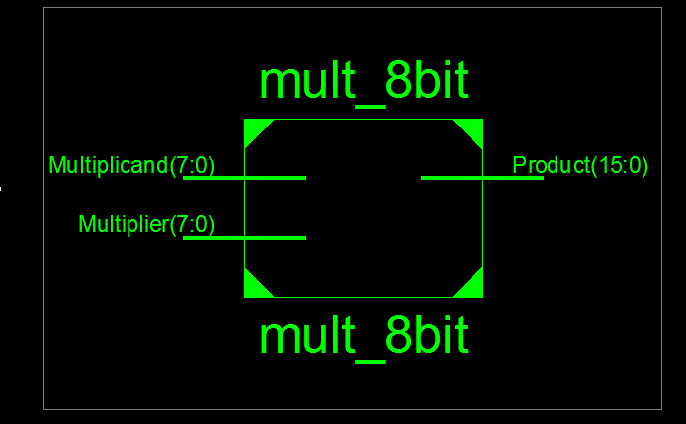
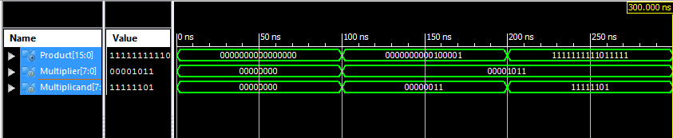
BLOCK DIAGRAM
WAVEFORM OF MULTIPLIER

Slide 12
BITWISE AND
Basic gate level implementation
Property of AND operator
1&1=1; other combination gives zero
i.e 1&0,0&1,0&0;
.... operating bitwise combination of corresponding two 8 bit Signed number resulting like above
..... Answer will be a 8 bit number

Slide 13
module bitwiseAND(A,B,C);
input [7:0]A;
input [7:0]B;
output [7:0]C;
assign C[0]=A[0]&B[0];
assign C[1]=A[1]&B[1];
assign C[2]=A[2]&B[2];
assign C[3]=A[3]&B[3];
assign C[4]=A[4]&B[4];
assign C[5]=A[5]&B[5];
assign C[6]=A[6]&B[6];
assign C[7]=A[7]&B[7];
endmodule
CODE BITWISE AND

Slide 14
module bitwiseAND_tb;
// Inputs
reg [7:0] A;
reg [7:0] B;
// Outputs
wire [7:0] C;
// Instantiate the Unit Under Test (UUT)
bitwiseAND uut (
.A(A),
.B(B),
.C(C)
);
TEST BENCH OF BITWISE AND
initial begin
// Initialize Inputs
A = 0;
B = 0;
// Wait 100 ns for global reset to finish
#100 A=8'b10010011; B=8'b11011000;
#100 A=8'b10101110; B=8'b00101000;
#100 $stop;
// Add stimulus here
end
endmodule

Slide 15
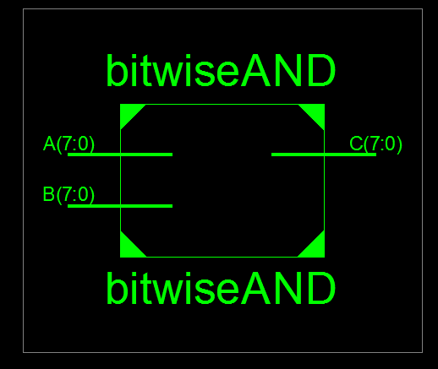
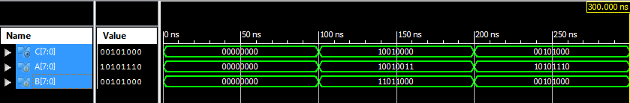
BLOCK DIAGRAM
WAVEFORM OF BITWISE AND

Slide 16
BITWISE XOR
Basic gate level implementation
Property of XOR operator (^)
(1^1,0^0)= 0; ( 1^0,0^1) =1;
Operation between corresponding bit of two 8 bit signed number resulting as above in 8 bit number.

Slide 17
CODE BITWISE XOR
module bitwiseXOR(A,B,C);
input [7:0]A;
input [7:0]B;
output [7:0]C;
assign C[0]=A[0]^B[0];
assign C[1]=A[1]^B[1];
assign C[2]=A[2]^B[2];
assign C[3]=A[3]^B[3];
assign C[4]=A[4]^B[4];
assign C[5]=A[5]^B[5];
assign C[6]=A[6]^B[6];
assign C[7]=A[7]^B[7];
endmodule

Slide 18
module bitwiseXOR_tb;
// Inputs
reg [7:0] A;
reg [7:0] B;
// Outputs
wire [7:0] C;
// Instantiate the Unit Under Test (UUT)
bitwiseXOR uut (
.A(A),
.B(B),
.C(C)
);
TEST BENCH OF BITWISE XOR
initial begin
// Initialize Inputs
A = 0;
B = 0;
// Wait 100 ns for global reset to finish
#100A=8'b10010011;B=8'b11011000;
#100 A=8'b11000101;B=8'b01101100;
#100 $stop;
// Add stimulus here
end
endmodule

Slide 19
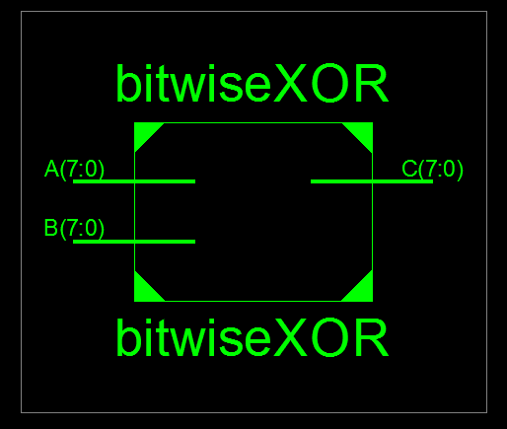
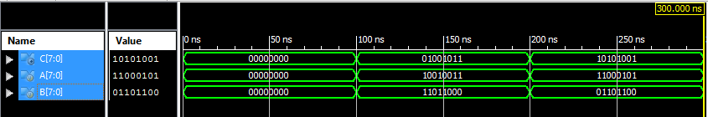
BLOCK DIAGRAM
WAVEFORM OF BITWISE XOR

